Slide 1
Race and Higher Education Selectivity
Nuray Özden, Srinitya Allam, Alexia Adams
4/25/2024
#5

Slide 2

62% of high school graduates go on to pursue post-secondary education
74.9% of all college students attend 4-year institutions

Slide 3
Research Question
How does race indicate the selectivity of institutions?
Hypothesis
In Logistic Regression models, more detailed race data better predicts the selectivity of colleges.

Slide 4
Related Work
"Analysis of AI Models for Student Admissions: A case study"
Revealed potential biases in admissions such as Legacy admissions
“many students who would not be admitted under test-required policies would be admitted under-test optional policies” (Van Busum 2023)
"Diversifying Society's Leaders? The Determinants and Causal Effects of Admission to Highly Selective Private Colleges" (Chetty, Raj et al. 2023)
Top-tier colleges, typically private and selective, have a bias towards high-income students
"The disparate impact of college admission policies on Asian American Applicants" (Grossman 2023)
Overall, Asian American applicants were admitted at lower rates than white applicants with identical test scores

Slide 5
Data
Created by researchers at Urban Data Catalog to analyze racial and ethnic representation in postsecondary education
Sourced from the Integrated Postsecondary Education Data System and US Census American Community Survey

Slide 6
Data Cleaning & Transformation
Removed ‘NaN’ values
Converted the selectivity to one-hot vector columns
based on Carnegie Classification of Institutions of Higher Education
Averaged the race percentage statistics over the 9-10 years
Scaled the percentages up to 100%
If current sum < 90%, delete
If current sum > 90&, individual percentages scaled up
Created col_poc column by summing col_black, col_hispa, col_asian, col_amind, col_pacis,and col_twora
Converted state and college to label encoded vectors

Slide 7
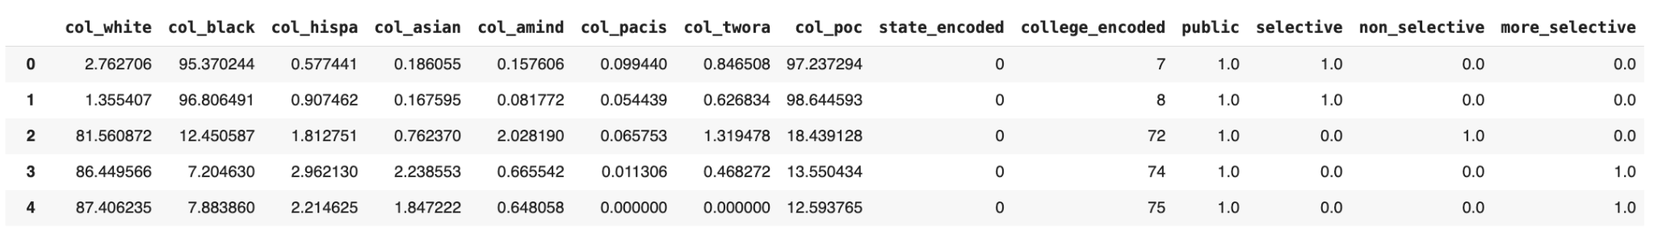
Cleaned Data
(Potential) Input Variables
col_white, col_black, col_hispa, col_asian, col_amind, col_pacis,and col_twora
col_poc
state_encoded
college_encoded
public
Target Variables
Selectivity (selective, non_selective, or more_selective)

Slide 8
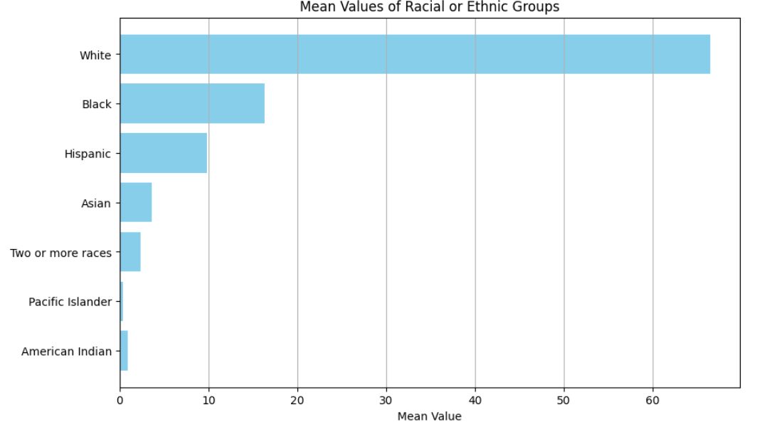
Summary Figures

Slide 9
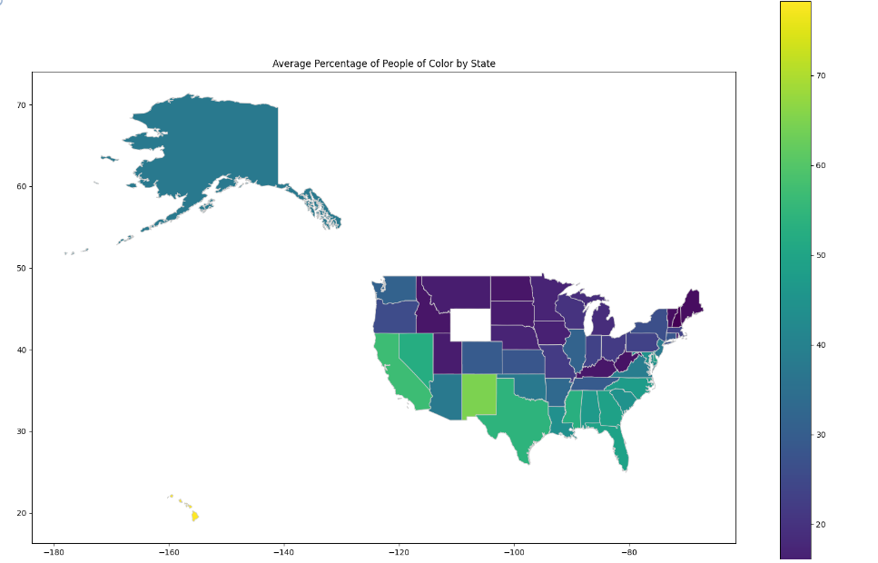
Summary Figures

Slide 10
Models
Logistic Regression models
Group 1
Group 2
Group 3
Non selective
Selective
More selective
Non selective
Selective
More selective
Non selective
Selective
More selective
Notes:
Chose to use logistic regression models because they are easily interpretable and good baseline models for comparing performance
Did a total of 9 models: Split up in 3 model groups that have different input variables

Slide 11
Model Groups
Group 1: No Race
Input Variables:
public
state_encoded
college_encoded
Group 2: POC Lumped
Input Variables:
public
state_encoded
college_encoded
col_poc
Group 3: POC Granular
Input Variables:
public
state_encoded
college_encoded
col_black
col_hispa
…
Target variables: non_selective, selective, more_selective
Notes:
Group 1: baseline
Group 2: poc lumped, use the col_poc
Group 3: used granular
Note: did not include col_white or private because of collinearity

Slide 12
Results

Slide 13
POC Granular better predicts more selective colleges
Model Type | Accuracy | AUC
No race | 0.816 | 0.512
POC Lumped | 0.816 | 0.694
POC Granular | 0.810 | 0.829
POC Lumped: negative coefficient for POC percentage
POC Granular: negative coefficients for Black, Hispanic, Indigenous, Pacific percentages
POC Granular: positive coefficients for Asian and Multiracial percentages

Slide 14
POC Granular better predicts non selective colleges
Model Type | Accuracy | AUC
No race | 0.642 | 0.621
POC Lumped | 0.676 | 0.669
POC Granular | 0.685 | 0.701
POC Lumped: positive coefficient for POC percentage
POC Granular: positive coefficient for Hispanic, Indigenous, Pacific percentages
POC Granular: negative coefficient for Multiracial percentages

Slide 15
POC Granular underperforms on selective colleges
Model Type | Accuracy | AUC
No race | 0.632 | 0.662
POC Lumped | 0.632 | 0.662
POC Granular | 0.620 | 0.647
POC Granular: negative coefficients for Hispanic and Asian percentages
POC Granular: positive coefficients for Black and Multiracial percentages

Slide 16
Limitations
College racial representativeness did not equal 100%
Represented the states as a numeric variable
Potential for underfitting
Many coefficients did not have statistical significance

Slide 17
Takeaways
POC Granular performs better than No Race and POC Lumped models when determining more_selective and non_selective
POC Granular performs worse when determining selective
Models mostly based on race data, lack other relevant details

Slide 18
Questions?

Slide 19
Sources
Chetty, Raj et al. 2023. Diversifying Society’s Leaders? The Determinants and Causal Effects of Admission to Highly Selective Private Colleges. Opportunity Insights. https://opportunityinsights.org/paper/collegeadmissions/
Grossman, J. et al. 2023.The disparate impacts of college admissions policies on Asian American applicants, National Bureau of Economic Research. https://www.nber.org/papers/w31527
Hanson, Melanie. 2024. College Enrollment & Student Demographic Statistics. EducationData.org. https://educationdata.org/college-enrollment-statistics
Kelly Van Busum and Shiaofen Fang. 2023. Analysis of AI Models for Student Admissions: A Case Study. In Proceedings of the 38th ACM/SIGAPP Symposium on Applied Computing (SAC '23). Association for Computing Machinery, New York, NY, USA, 17–22. https://doi.org/10.1145/3555776.3577743
Monarrez, T. and Washington, K. (2020) Racial and ethnic representation in postsecondary education, Urban Institute. https://www.urban.org/research/publication/ racial-and-ethnic-representation -postsecondary-education
Washington, T.M. and K. (2020) Racial and ethnic representativeness of US Postsecondary Education Institutions, Urban Data Catalog. https://datacatalog.urban.org/ dataset/racial-and-ethnic- representativeness-us-postsecondary-education-institutions.
GeoJSON download source: https://hub.arcgis.com/datasets/1b02c87f62d24508970dc1a6df80c98e

